Slide 1

Image Segmentation Using Machine Learning
SUBMITTED BY – Parth Shukla (112015099)
GUIDED BY –
Dr. Anil Rajput

Slide 2
Table of Contents
Introduction.
Motivation
Problem Statement.
Proposed Solution.
Technology Used.
Future Work.
Conclusion
Reference

Slide 3
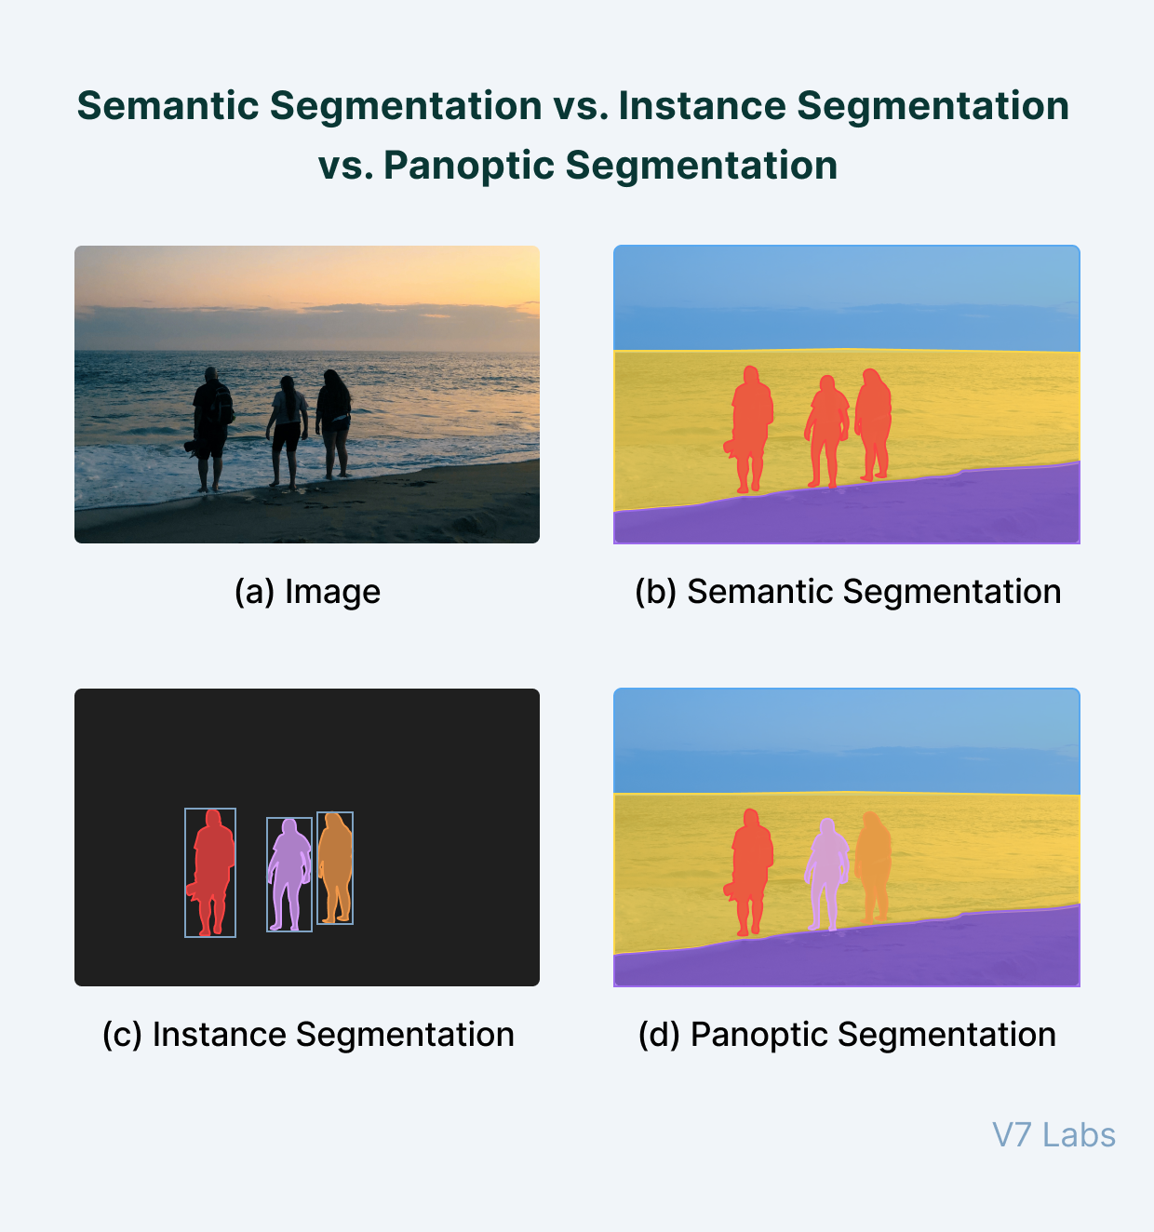
INTRODUCTION
In computer vision, image segmentation is the process of partitioning an image into multiple segments. The goal of segmenting an image is to change the representation of an image into something that is more meaningful and easier to analyze. It is usually used for locating objects and creating boundaries.
Image segmentation is an extension of image classification where, in addition to classification, we perform localization.

Slide 4
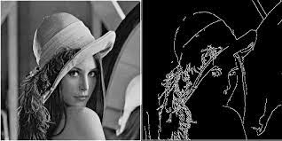
Motivation
In fields like medical Imaging image segmentation have to be highly accurate. This is where traditional segmenting algorithms fails.
The main drawbacks with the conventional image segmentation techniques are over segmentation and high sensitivity to noise.
Segmenting image with smooth edges

Slide 5
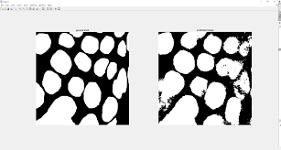
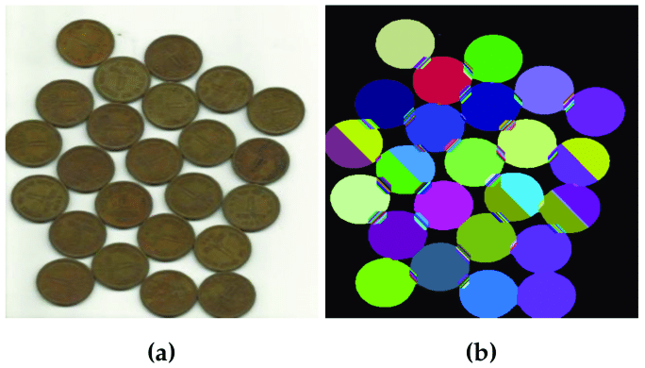
Motivation
Segmentation with noises
Over Segmentation of image

Slide 6
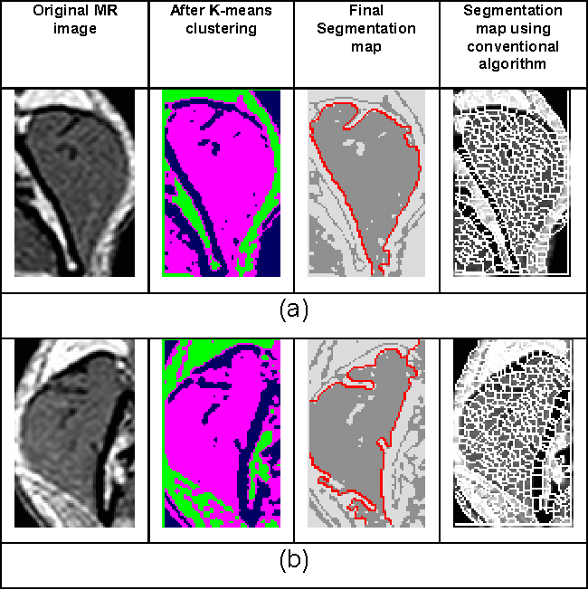
Motivation

Slide 7
Problem Statement
Thus from above motivation we choose Problem Statement of building a Machine Learning application that can be used for high precision segmentation of images.
Our idea is to create Machine learning Model which is trained in such a way that it can perform segmentation of image in accurate and efficient way.
Input Image
Trained Model
Segmented Image

Slide 8
Proposed Solution
Mask R-CNN
Mask R-CNN, or MRCNN, is a type of Convolutional Neural Network (CNN) and state-of-the-art in terms of image segmentation and instance segmentation. Mask R-CNN was developed on top of Faster R-CNN, a Region-Based Convolutional Neural Network.
Mask R-CNN is an object detection model based on deep convolutional neural networks (CNN) developed by a group of Facebook AI researchers in 2017.

Slide 9
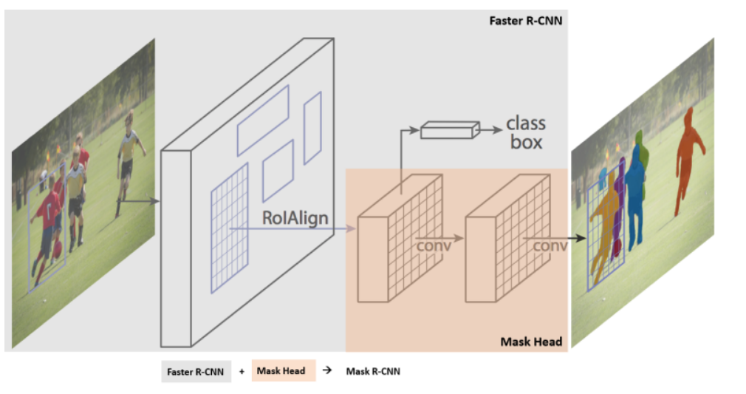
Proposed Solution

Slide 10

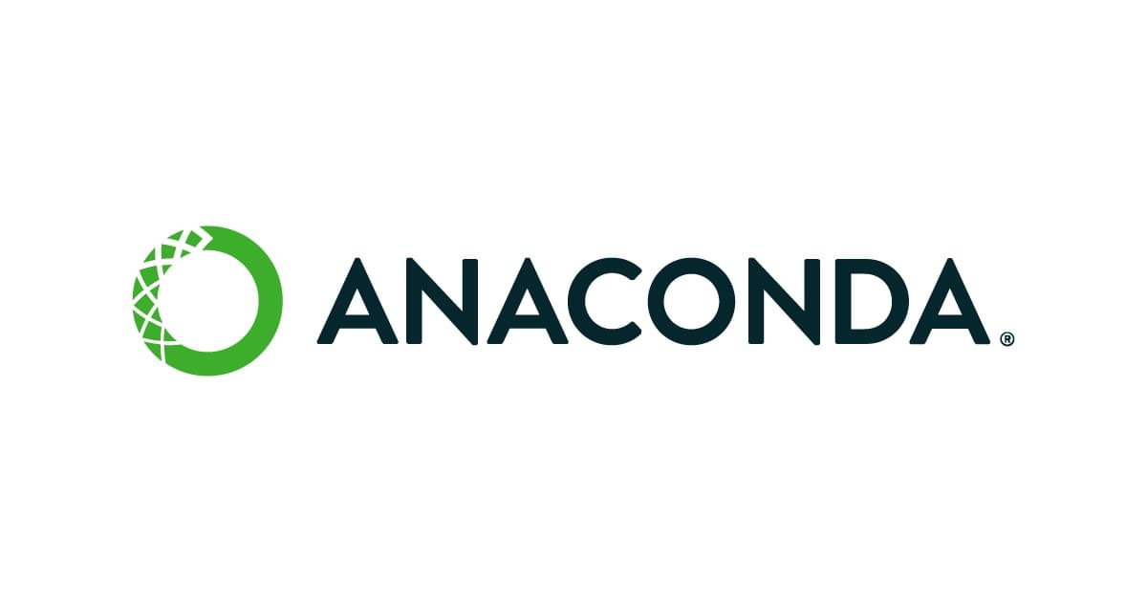

Technology Used
Python-
Libraries used are -
OpenCV
TensorFlow
Keras
Anaconda
Jupyter Notebook

Slide 11
Future Work
This type of segmentation technique provide high accuracy of segmentation and can be used in sensitive visual fields like medical imaging.
This type of model can be used in areas where intelligent networks can be used to predict the class label of objects like in self-driving cars etc.
Here, an opportunity is to design standardized image databases that can be used to evaluate fast spreading new diseases and pandemics.
This method can been successfully applied to segment satellite images in the field of remote sensing, including techniques for urban planning or precision agriculture.

Slide 12
Conclusion
This presentation comprehensively reviews R-CNN based Image Segmentation algorithms and introduces it’s applications.
The review shows that R-CNN has great potential to segment images accurately, and this can further promote the transformation of practice from experientialism to digitization, precision, and individuation.
For a dataset of a particular field this model will produce the segments of the image with high accuracy and precision with less time required.
In the future, more research is needed to further improve the accuracy of automatic image segmentation and realize intelligence.

Slide 13
References
Sr No. | Research paper | Publish Year | Description
1 | Limitations of Traditional Image Segmentation Techniques in Medical Images: A Review | March 2021 | sensitivity to noise, poor handling of complex images, and dependence on user-defined parameters
2 | Disadvantages of Traditional Image Segmentation Techniques in Autonomous Driving: A Review | 2022 | poor handling of occlusions, and dependence on illumination conditions, sensitivity to noise.
3 | Challenges and Limitations of Traditional Image Segmentation Techniques: A Review | Dec 2020 | It involves partitioning an image into multiple regions or segments based on various visual cues such as color, texture, and shape. Traditional image segmentation techniques, such as thresholding, region growing have been widely used . But there are some limitations. To over come this Limitation, we can use K-means clustering ,fuzzy clustering.

Slide 14
Sr. No | Research Paper | Published Year | Description
4 | The Limitations of Traditional Image Segmentation Techniques in Remote Sensing Applications | May 2021 | Remote sensing Applications means analysing satellite and aerial images to extract useful information about the earth's surface. Traditional image segmentation techniques, such as thresholding, region growing, and edge-based methods, have been widely used in this context
5 | A New Welding Seam Recognition Methodology Based on Deep Learning Model MRCNN | Nov 2021 | the welding stereo vision system is normally used to get position of joints by scanning the whole profile of work piece, To guide the robot and welding system we used vision guided system. But it can move along straight line of curves. To solve this, we used Mask R-CNN to obtain the accurate position of solder joint.

Slide 15


